Slide 1
Git Intro Activity
Darci Burdge
Stoney Jackson

Slide 2
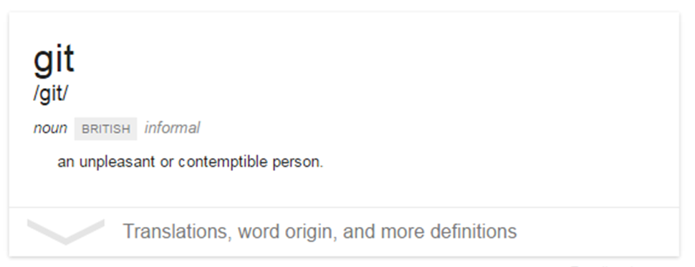
What is Git?

Slide 3
What is Git?
Git is a version control system
It allows you to keep track of changes to a set of files over time
You can also revert back to the previous state of a file

Slide 4
Team Formation
Roles:
Driver: Creates and maintains a local git repository
Navigator: Ensures that the team is following the activity
Recorder: Records all answers and questions
For teams of 2, combine the navigator and recorder roles
Record answers to questions on a titanpad; use your first names, for example, titanpad.com/JoeMarySue

Slide 5





Who we are – foss2serve.org
Acknowledgement
This material is based on work supported by the National Science Foundation under Grant Nos. DUE-1225708, DUE-1225738, DUE-1225688, DUE-1525039, DUE-1524898, and DUE-1524877. Any opinions, findings and conclusions or recommendations expressed in this material are those of the author(s) and do not necessarily reflect the views of the National Science Foundation (NSF).
Copyright and Licensing
This work is copyrighted by Darci Bruge and Stoney Jackson
This work is licensed under a Creative Commons Attribution-ShareAlike 4.0 International License http://creativecommons.org/licenses/by-sa/4.0/

